Slide 1

Covid – 19 Impact : City of San Antonio/ Bexar County
Contributors:
Uma Yeruva,
Samantha Brown,
Ahmed Dahham & Julia Lira

Slide 2
Data Definitions

Slide 3
Sorting and Cleaning Data
Relationship of population to Vaccination Rate
Bexar county Vaccination rate
( Single dose vs Fully Vaccinated)
3. Comparison of Fully Vaccinated vs Single Dose
by:
Age
Gender
Ethnicity
5. Limitations

Slide 4

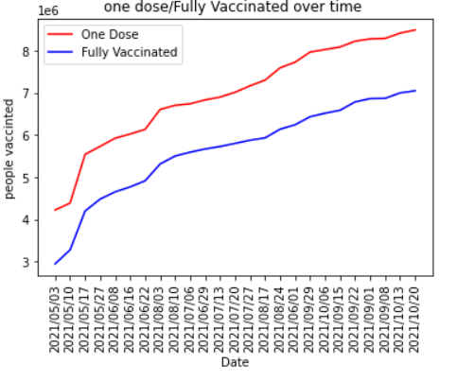
Bexar County Vaccinations One Dose vs Fully Vaccinated (Timeframe : May 3,2021 – Oct 10, 2021) *****WE WANT THIS SAME GRAPH BUT GROUP BY MONTH and format axis and add unit of measurement for Y axis

Slide 5
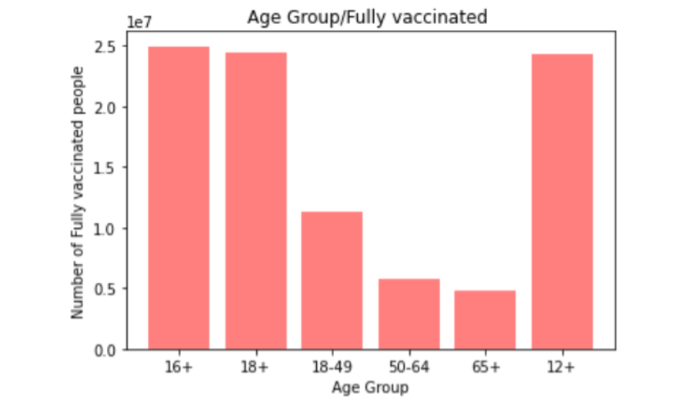
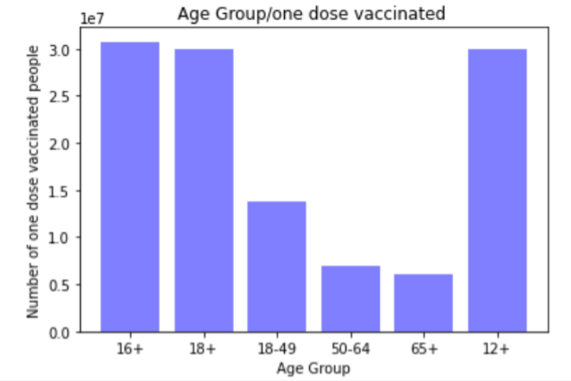
Comparisons: Age
Relationship of Age correlation to Fully Vaccinated vs Single Dose
Combine carts with two colors and sort and *validate data*
If we have time do population vaccinated % percentages

Slide 6
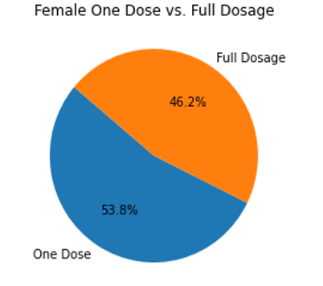
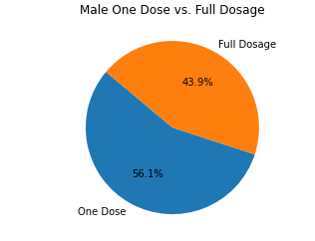
Comparisons: Gender
Relationship of Gender
Vaccinated vs Single Dose
***highlight which gender received full does using bar chart

Slide 7
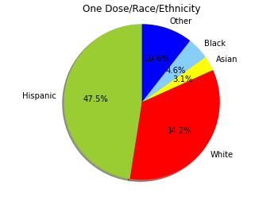
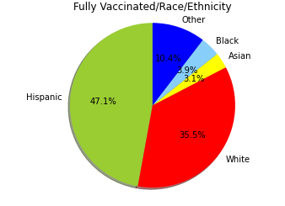
Comparisons: Race / Ethnicity
Relationship of Race / Ethnicity
Fully Vaccinated vs Single Dose
*** If time permits redo graphs (stacked Bar)***

Slide 8
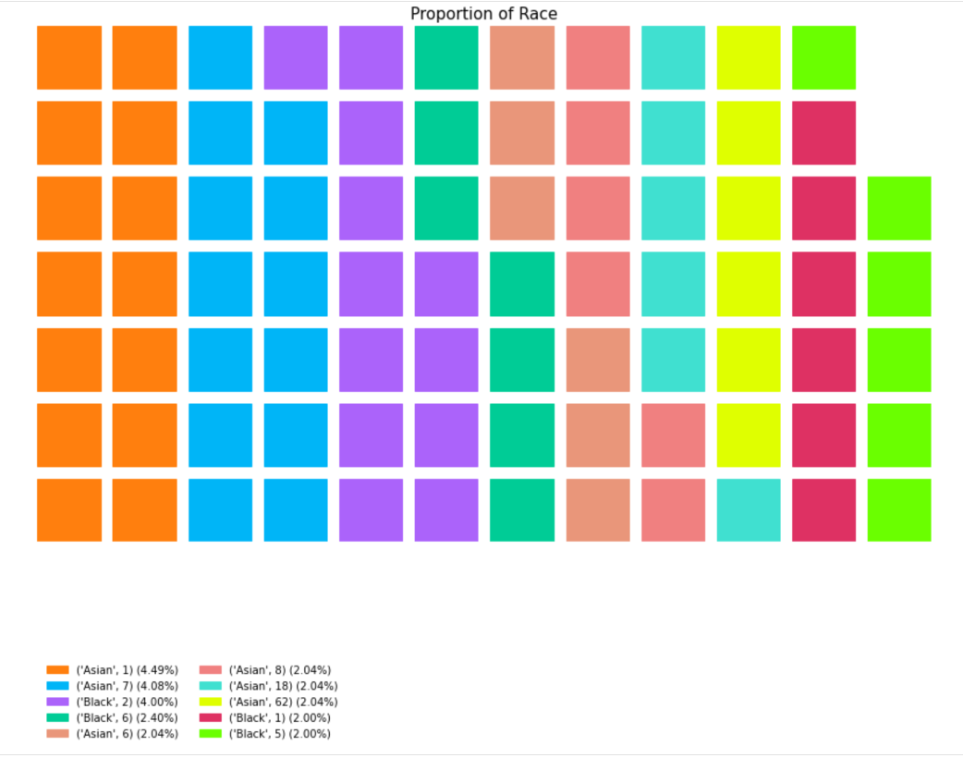
Need a Completely different graph for vaccination status by race or delete completely
Is proportion to total population?

Slide 9
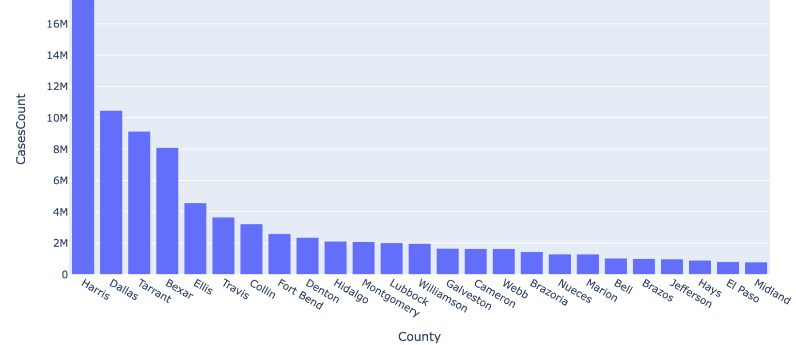
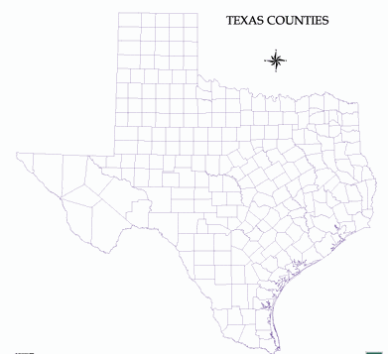
Other TX counties by comparison ( top 5 vs bottom 5 counties vaccinated )
Title does not match graph
Case count or Vaccine count???
Compare urban counties to urban counties and rural to rural for vaccine rates and case or death counts (top 5 of each)

Slide 10
Correlation ****death count and vaccine rate & Conclusion Direct correlation shows vaccination increase lead to lowering of cases ****

